Slide 1




Super easy navBar and scroll-to-top button for your Datorama Dashboard:
Datorama Custom widget
Bootstrap
Font Awesome

Slide 2

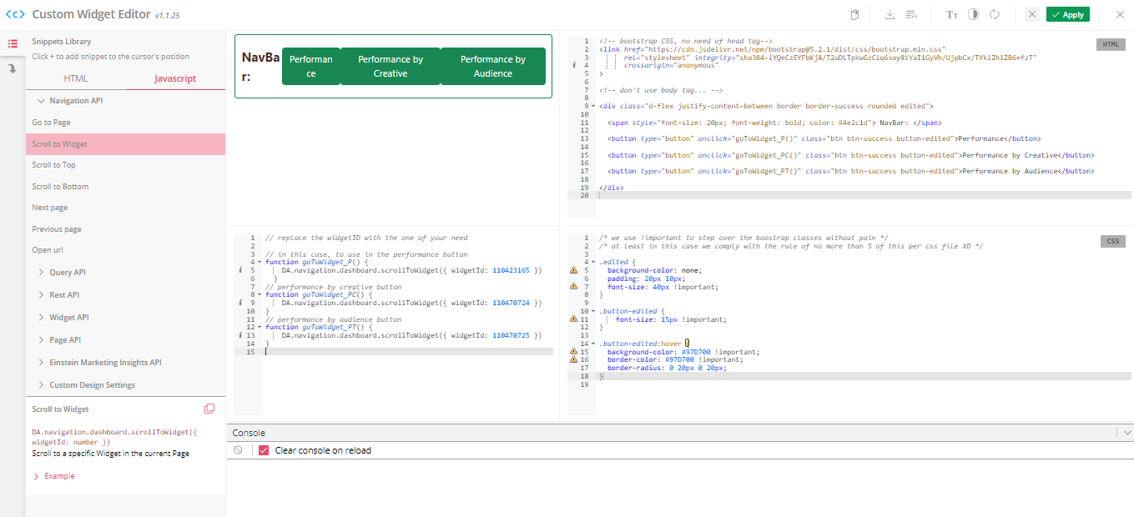




Responsive NavBar BUT
using just buttons [getbootstrap.com]
DEFAULT
:HOVER

Slide 3


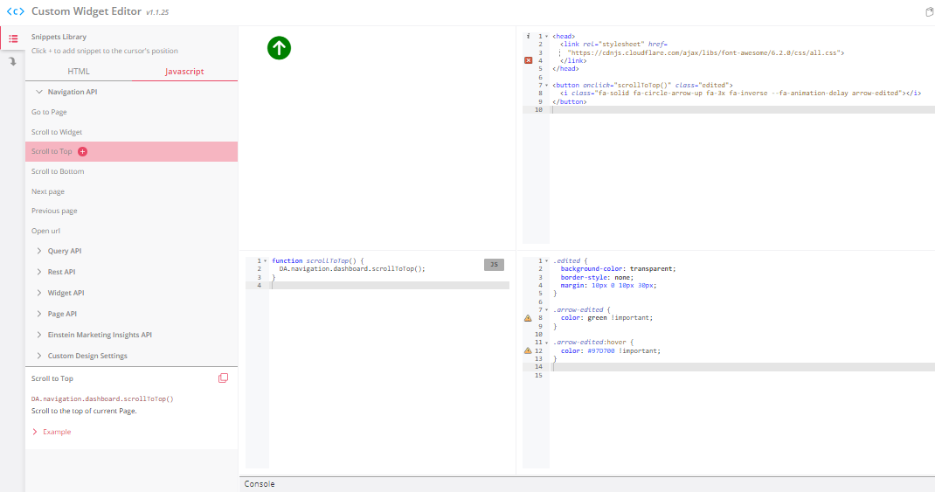
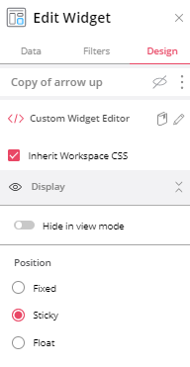
SCROLL-TO-TOP STICKY BUTTON using fontawesome.com as workframe
:HOVER
transparent ;)
Go sticky

Slide 4
if you want the code files just ping me via dm Best!
FJ

